Slide 1
Tips and habits to advance your IT career
By @arielsanchezmor
V1.1 (added links)

Slide 2
My disclaimer slide
Notice, no VMware logos
Submitted it as a community session for VMUG
I’m talking about my own experience and also lessons learned from meeting others
I am a VMware fanboy though ☺
I think it’s important that we share stories, tips and lessons learned in the vCommunity
Slides will be posted in my Github repo / blog

Slide 3
Let’s have some fun
Take a pic of yourself seeing this recorded session! Tweet it out with #VMUGVirtual
I really like interacting with people in Twitter and the #vCommunity – send me any thoughts from today, your cat pictures and your blog posts!

Slide 4
A bit about me
Costa Rican in Orlando via SJO, Denver, NYC, PGH
Advocate of the vCommunity (vBrownBag, vExpert, VMUG, Hackathons, vBeers, etc!)
I want to help you present at your VMUG!
vExpert PRO – I’ll help you prepare for vExpert
My job: Senior Technical Account Manager @VMware
Office of the CTO, Ambassador

Slide 5
Agenda
Realities of working in IT
My career journey and what I learned
The vCommunity and social media
Tips and habits, odds and ends

Slide 6
Realities of working in IT
IT can give you a comfortable living
Work/life balance is difficult at the beginning
Long hours and graveyard shifts get old
Be mindful of your health!
Always be aware of what’s coming
Your job will change every 5 years
In IT, people take jobs to learn skills
Same job salary increases don’t match inflation

Slide 7
My career journey and what I learned
#1 NOC engineer, team lead in Costa Rica
Pros: managers, team, tech, opportunities
Cons: some teammates, upward options, shifts
Big Breaks: travel, responsibility
Painful lessons learned: your career is your duty
#1 Tip: Documentation is a golden entryway
Book: Eat that frog

Slide 8
Eat that Frog highlights
21 tips in condensed manner for personal productivity
Complete your most important task first and well
Write things down, Plan, Prioritize
Laser focus on big impact tasks, 80/20
Find and focus on your strengths, rather than being an all rounder
Create large chunks of time

Slide 9
My career journey and what I learned
#2 IT coordinator in Costa Rica, different company
Pros: salary, prestige, much bigger company
Cons: tough (but fair) boss, long hours, email
Big Breaks: scripting, negotiating
Painful lessons learned: managing people is hard
#1 Tip: Rely on your peers
Book: Winning, One Minute Manager

Slide 10
One Minute Manager, Winning highlights
Focus on leading effective and engaged teams:
Communication is simple if we take the time to agree with each other and commit.
Candor is essential!
Rewards have to align with performance
Get your team to think aloud, debate & agree
Hiring and letting go are important decisions
So much more about thinking like a CEO

Slide 11
My career journey and what I learned
#3 IT Manager for 3 countries, still in Costa Rica
Pros: prestige, mentoring, travel, team building
Cons: letting people go, more personalities
Big Breaks: excellent coordinators
Painful lessons learned: weight of responsibility
#1 Tip: Build relationships; Get out of the way
Book: none - I asked my director’s advice

Slide 12
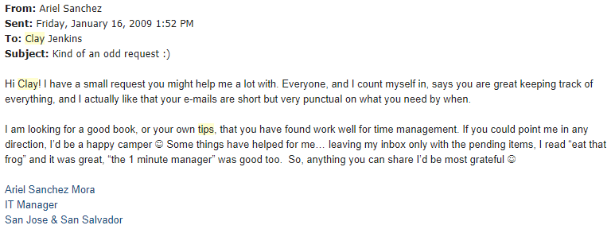
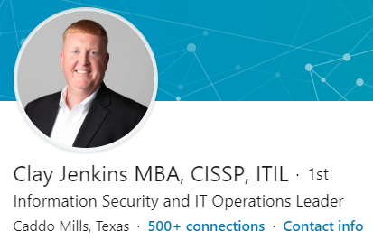
Ask your seniors for tips!
- Ask those you admire
- People generally are nice about it!

Slide 13
Some of Clay’s tips from 2009
I only answer what I think people can’t handle (not saying be hands off 100%) but do my best to let people run with it.
I always tell my people (directs and indirects) if you need me you better find me. If they don’t, I chew their tail when they get caught. If they do, I protect them.
Always try to make political points. Never be afraid to tell anyone NO (just be able to back it up) no matter what level they are. Those NO’s allow you to spend those political points.

Slide 14
Some of Clay’s tips from 2009
Be human, not a robot leader. I try to get to know what's going on personally with people so that when something is bothering them, I know it and can understand and cut em some slack.
Spend money when you must (and I mean on making people happy). I mean if they need pens or a lunch sometimes then do it. Don’t ask your boss, just do it and keep your people happy.
Be honest with your people. I hate keeping things (good or bad) from people. You tell people the bad and they respect you as honest and will follow you more.

Slide 15

Relocated to Denver
#4 Junior SysEng, End User Support and DC Tech
Pros: Denver, learning, US Salary, career path
Cons: on call for syseng and datacenter ops
Big Breaks: VMware course!
Painful lessons learned: work/life balance
#1 Tip: Learn, document, spread
Book: Mastering VMware vSphere
by Scott Lowe

Slide 16
Relocated to Brooklyn
#5 VMware SME (still same company)
Pros: WFH, Salary increase, more fun at work & city
Cons: NYC is expensive, car and house are luxuries
Big Breaks: VMUG! Working with @edmsanchez13
Painful lessons learned: IT Admin Health
#1 Tip: Rely on the vCommunity
Book: *every other VMware Press book*

Slide 17
Relocated to Pittsburgh
#6 Sr Technical Account Manager for VMware
Pros: no more on call rotation, + salary, VMware!
Cons: drinking from fire hose, 1 yr to feel adept
Big Breaks: Excellent teammates, culture, PGH=cool
Painful lessons learned: Being on time, $100 bill
#1 Tip: Stay true to yourself, homelab, geek out!
Books: The Greatest Salesman in the World

Slide 18
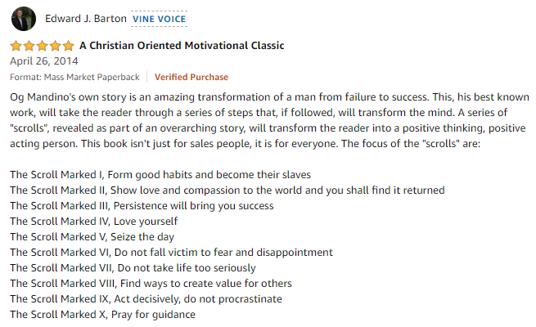
Greatest Salesman… highlights

Slide 19
Asking for tips + “Managing up”
Asking for advice should be additional from “managing up” and getting clear direction
Talk to your manager on how to work together
Consistently managers want:
1) Integrity
2) Speak up if there’s problems
3) Honor your commitments with quality
4) Respect others (golden rule, be on time, etc)
5) Admit mistakes and learn from them

Slide 20
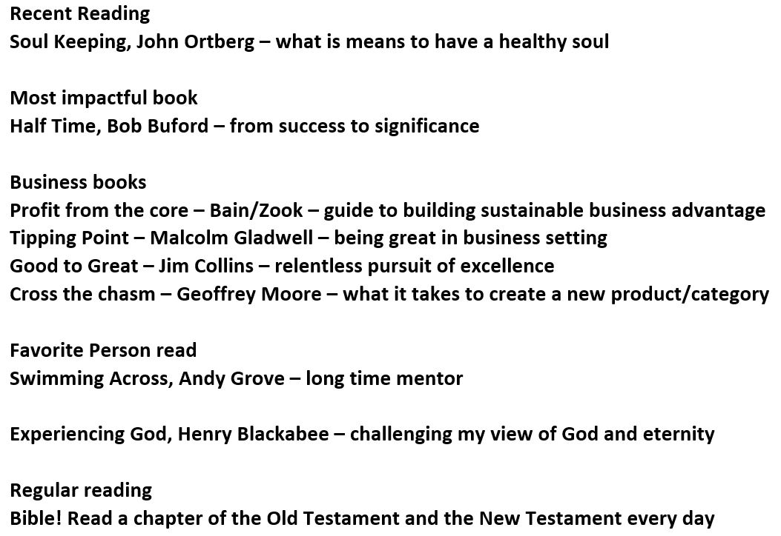
Ask your seniors for tips - on steroids
VMware has an AskPat mailbox, so I asked him for book recommendations, and he replied :yay:

Slide 21
Find who you admire on Social Media
Pat Gelsinger is a world known leader, so he’s been interviewed several times on career advice:
https://www.linkedin.com/pulse/eight-books-expanded-my-thinking-pat-gelsinger/
https://developgreatmanagers.com/interviews/pat-gelsinger-incredibly-successful-executive-with-the-right-priorities/
https://www.businessinsider.com/career-advice-vmware-ceo-pat-gelsinger-how-to-be-a-ceo-2017-3

Slide 22
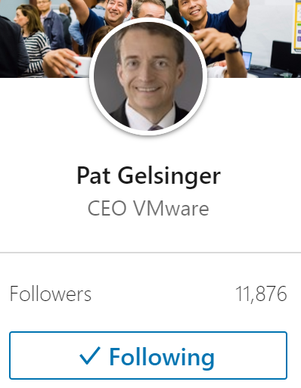
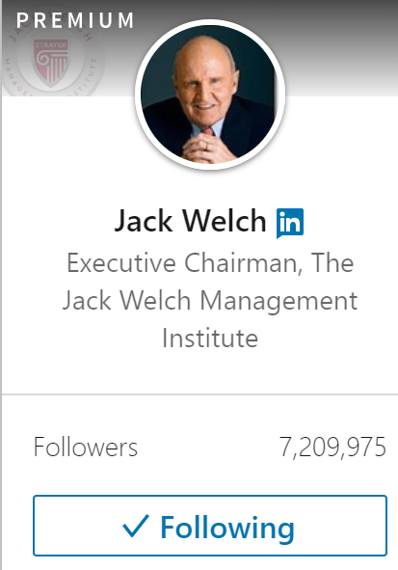
Social Media as a career tool
There are still those who think social media is just facebook, ie, a waste of time
If you’re a manager, director and above, LinkedIn has lots of free articles from authors and CEOs

Slide 23
Community
A group of people living in the same place or having a particular characteristic in common
A feeling of fellowship with others, as a result of sharing common attitudes, interests and goals
There are lots of IT communities!

Slide 24
vCommunity
The very welcoming people working with virtualization technology who you frequently meet at VMware user groups and conferences.
Typically they are active on twitter and they blog, and are characterized for being very willing to share information

Slide 25
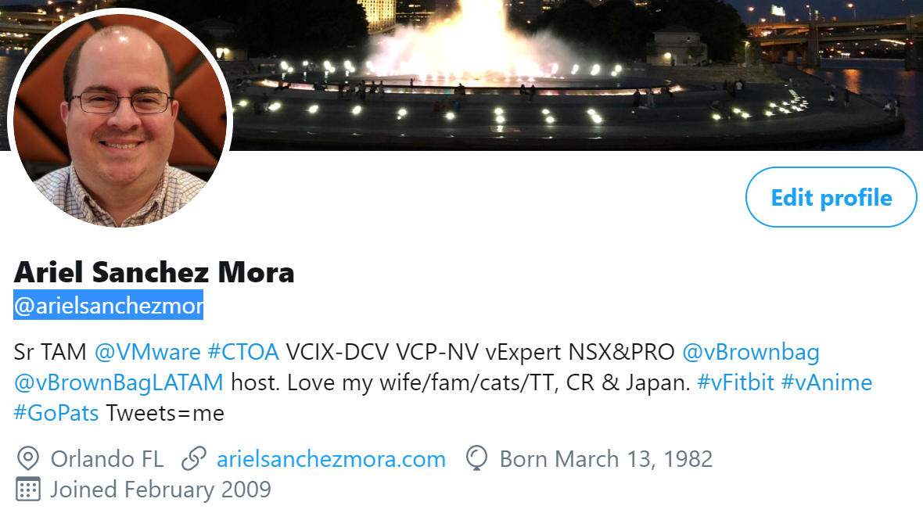
Starting on Twitter
Twitter: spreading info and short discussions
-global directory of people, lots of techies -‎hashtags are powerful!
#vExpert
#VCDX
#VMware
#vCommunity

Slide 26
More ways to do vCommunity
VMTN forums
Reading and commenting on other’s blogs
LinkedIn/Facebook/Whatsapp/Telegram
Podcasts and webinars (Geek Whisperers, vBrownbag)
Share and use code through Github/Gitlab
Assisting to VMUG and VMworld events
Slack chats like VMware Code

Slide 27
VMUG is HUGE
VMUG Critical: reach out to the VMUG leaders, that they know who you are and offer them to present in the future
Leaders are so important to the vCommunity
Hang out in the common areas and talk to others
Check twitter, there’s always a hashtag
Tailor the event so that you get what you want, but you also get pushed!

Slide 28
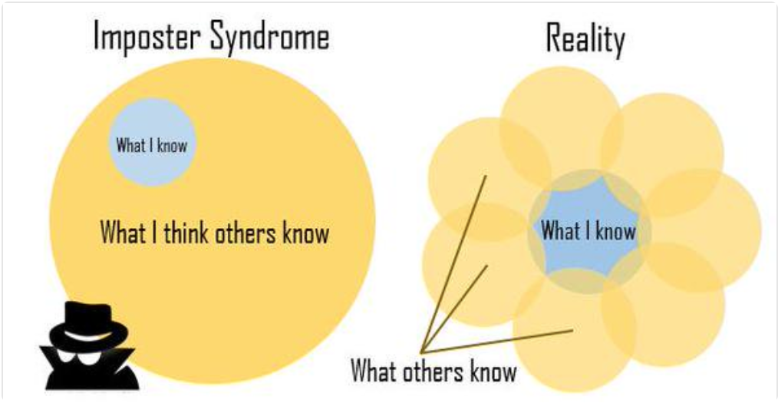
4 stages of participation
-lurk
-‎interact
-‎contribute
-‎mentor
You will learn so much more from teaching others
Presenting itself is something that takes practice to do well
Just try to get better each time. That’s all!

Slide 29
Easy ways to start
You feel you need to learn more? Volunteer at work to help in the difficult VMware projects
You’re learning enough? Take notes, sanitize the data for internet, and blog about it
Can’t really test and do stuff at work? Homelab! VMUG Advantage is a great value
$12 domains.google.com Blogger, wordpress.com, GitHub pages, Medium, etc

Slide 30
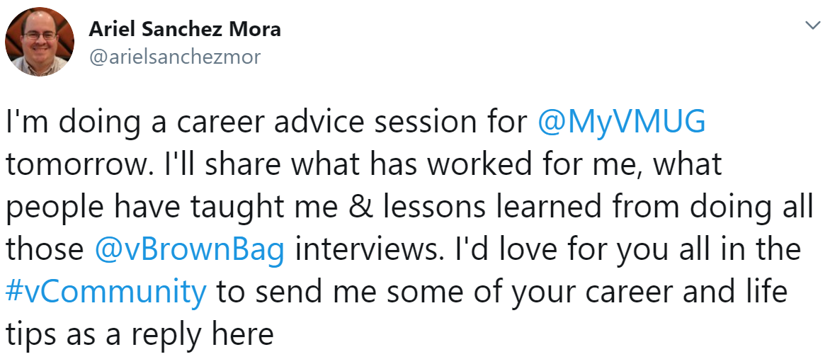
vCommunity is a sounding board
https://twitter.com/arielsanchezmor/status/1154488650995863553

Slide 31
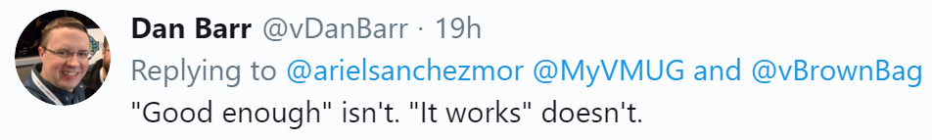
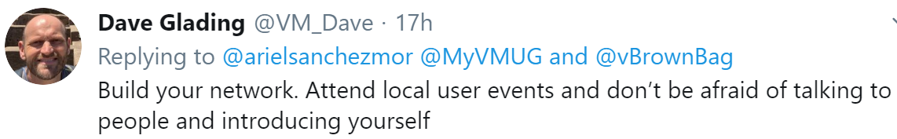
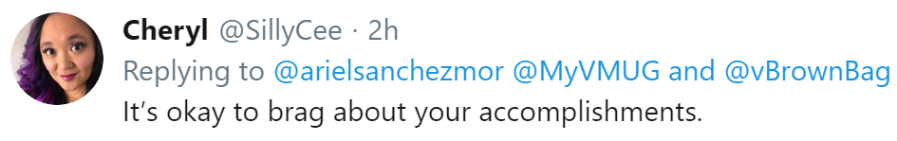
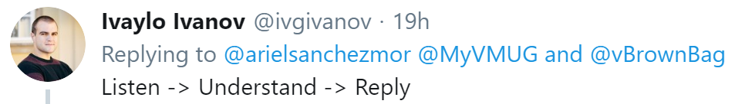
vCommunity is sharing

Slide 32
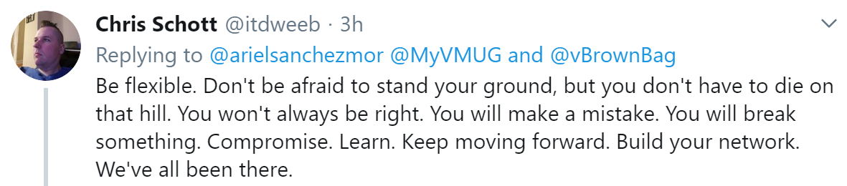
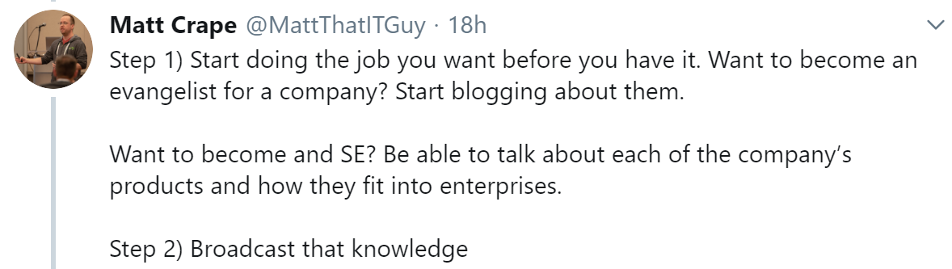
vCommunity is sharing

Slide 33
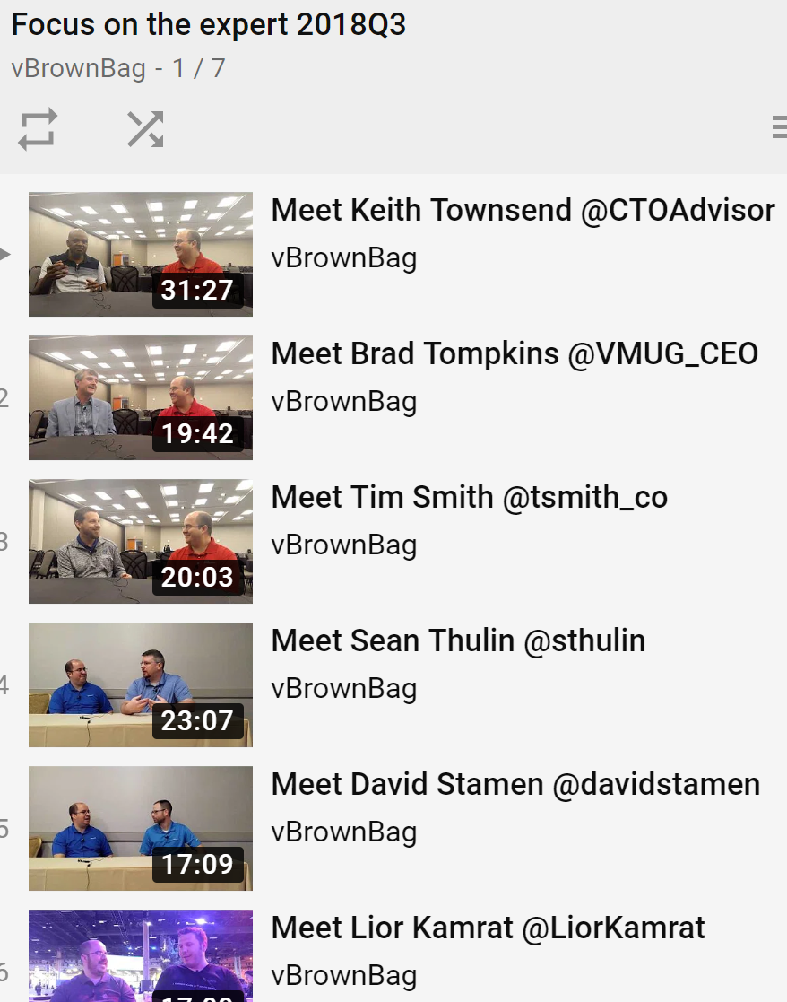
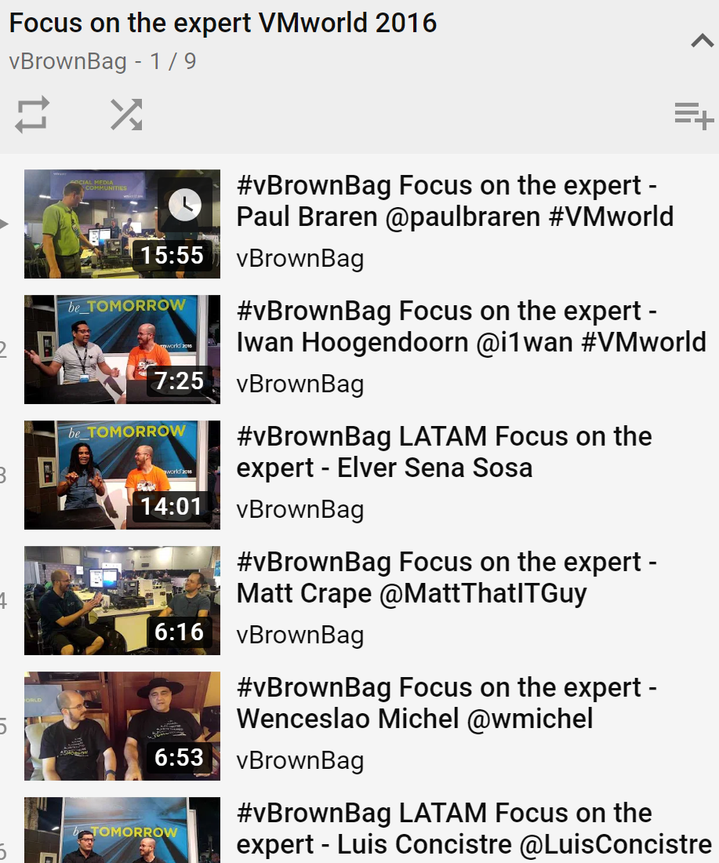
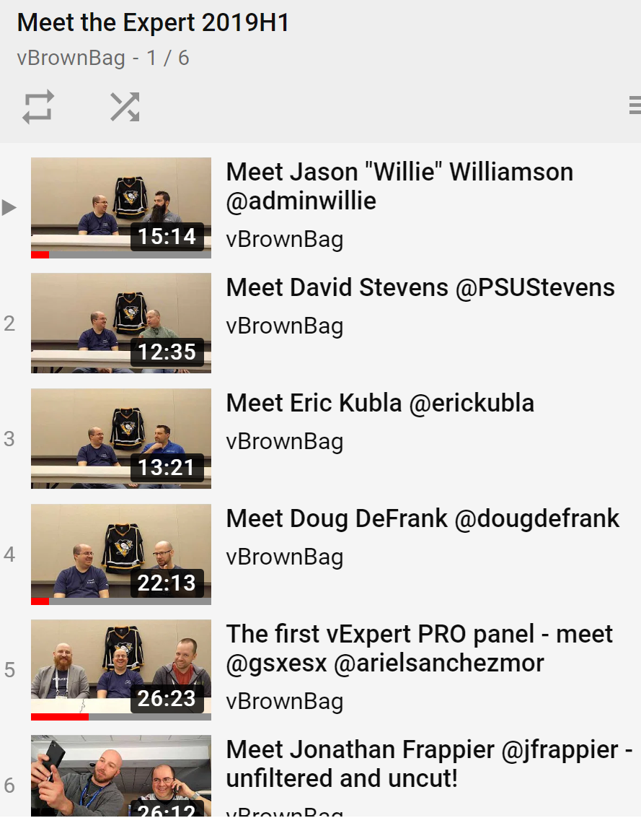
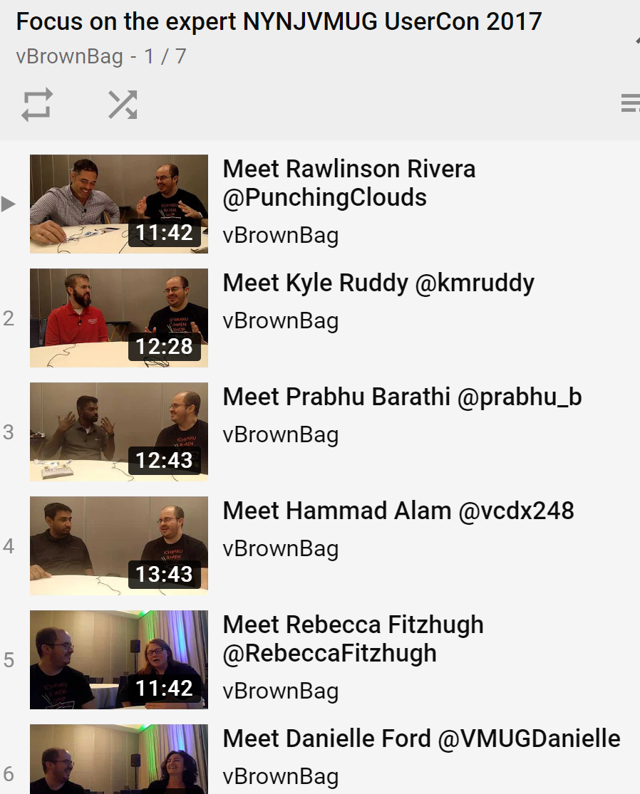
vCommunity is sharing
Since 2016, I’ve done several interviews for vBrownBag to members of the vCommunity

Slide 34
Help organize meetups, local or online
All of these, twitter hashtags!
-vBeers -vBrisket -‎vCurry -‎vChicken -‎vCoffee -‎vAnime -‎vFitbit -‎vGamers (vgamers.gg)

Slide 35
BENEFITS
All of this will bring you -Friends!!! -‎Contacts for when you need help -‎”Resume” to apply for vExpert and others
-‎New knowledge - keeping up to date! -‎Knowing who knows about X -Access to career mentors

Slide 36
Vendor award programs
vExpert Veeam Vanguard EMC, Cisco, RedHat, etc Free licenses and subscriptions Swag Private events Beta and feedback groups
- The networking in these groups is invaluable!!

Slide 37
Important habits
Being active in the vCommunity teaches you: - You could be doing things better -‎ There is value in having frank good-intentioned discussions with colleagues -‎ Knowledge hoarding is a negative attitude
- The more you share, the better it is for everyone, but especially yourself!
- You can only do new things if you stop doing old things. Unreplaceable means unpromotable!

Slide 38
Thank you!
I’ll leave you with a full, revised version of Clay’s management philosophies. It’s a whole presentation by itself ☺
Reach out on twitter! @arielsanchezmor
Blogs.arielsanchezmora.com will have a blog post related to this talk as well

Slide 39
Clay (and Bob’s) philosophies
Management Philosophies
Remember that these are just philosophies, not rules. Please use them to guide your decisions, not make them!
When working with subordinates, if your gut tells you it isn't going to work out, it almost never does. If your instincts tell you they are not a fit, they probably aren't.

Slide 40
Clay (and Bob’s) philosophies
When you are in management there is no excuse. If the end results are not what you wanted, there is something you could have/should have done differently. This doesn't mean that you beat yourself up over it. It does mean you constantly review your actions (when the results are not good) and decide what could you/will you do different the next time. Make sure all your decisions are based in reality. Understand the people/teams you are dealing with and make sure your plan fits well with their strengths and weaknesses. All too many plans fail with the excuse "if only they had done what I asked"; don't let this happen to you.

Slide 41
Clay (and Bob’s) philosophies
All IT managers are authorized to “push back” on requests from our internal customers if they believe it is in the best interest of the company. If they do so, they are then required to invite the customer to escalate to their supervisor. We cannot always say “yes” to every request but we should make it clear that a “no” is not necessarily the final answer.

Slide 42
Clay (and Bob’s) philosophies
Hold employees accountable. Clearly set the guidelines, rules or direction and then challenge them every time they veer from the path. Any other approach sends mixed messages.
Good people are hard to find. If you have a valued employee with personal circumstances making it difficult for that person to work for Stream, get creative with schedules or working environment to allow that person to continue working for you.

Slide 43
Clay (and Bob’s) philosophies
If you see something that doesn’t seem or feel right, don’t assume management knows about it – raise a flag and escalate it. There are few things worse than uncovering a serious problem that has existed for a while and is known by people in the department who didn’t raise an alarm because they assumed management knew and was okay with the situation. If something is not right, take the initiative to alert the right people and make it right. I liken this to ”if you see a piece of trash in the hallway pick it up; don’t leave it for the janitorial staff”, “if you see lights left on at the end of the day, turn them off”, etc.

Slide 44
Clay (and Bob’s) philosophies
Promote from within (especially in management) – If you have a team you trust you can always promote from within. It make people feel better and shows there is opening for opportunity. If you have to go outside to find the skills then you should have developed your internal people better. Only go outside when you need something you don’t have (don’t make it a practice).

Slide 45
Clay (and Bob’s) philosophies
Treat our people as professionals and expect them to act as professionals. If they don’t, release them.
If you are working extraordinary long hours: for the 1st 6 months it is the job; after 6 months it is the person. It is okay when a person works long hours because that is his/her work style but they should not blame it on the job. I have never asked for martyrs and don’t necessarily respect martyrs. I respect the person that has established the proper balance between home, family and work and gets the job done without negatively affecting home and family.

Slide 46
Clay (and Bob’s) philosophies
Say “yes” graciously and quickly. When a customer (internal or external) asks you for something, quickly analyze the request and situation and decide if you are going to end up honoring the request. If the answer is “yes” then give it willingly with a “great customer service” slant. Too often we say something like “oh well, I guess if we have to we will but it won’t be easy and will really take a lot of time and effort”. When this happens, we end up performing the task while the customer walks away without feeling they have experienced “great customer service”. In other words, we end up doing the work but not really getting credit for it.

Slide 47
Clay (and Bob’s) philosophies
“No surprises” - keep your supervisor well informed. No one likes to be blindsided. Make it your mission to ensure your boss is properly alerted to possible problems and issues. Make sure he/she hears it from you first rather than from his/her boss or a peer.
Incredible focus – Doing one thing well is much better than doing many things poorly. If you have too many things on your plate to do them justice, work with your manager to reduce the items you are focused on to a manageable level.

Slide 48
Clay (and Bob’s) philosophies
Not getting burned by the same problem twice – getting burned once by an unforeseen event or happening is life; getting burned twice is negligent.
“To Do’s” that are needed by other team’s project will always take a high priority. When trying to assign priorities because a team has more on their plate than they can handle you should usually give the nod to needs presented by other teams. There is nothing more frustrating to a team (and costly to the department) than to hit a wall and lose momentum due to needing resources or help from another team.

Slide 49
Clay (and Bob’s) philosophies
If you see something that doesn’t seem or feel right, don’t assume management knows about it – raise a flag and escalate it. There are few things worse than uncovering a serious problem that has existed for a while and is known by people in the department who didn’t raise an alarm because they assumed management knew and was okay with the situation. If something is not right, take the initiative to alert the right people and make it right. I liken this to ”if you see a piece of trash in the hallway pick it up; don’t leave it for the janitorial staff”, “if you see lights left on at the end of the day, turn them off”, etc.

Slide 50
Clay (and Bob’s) philosophies
Promote from within (especially in management) – If you have a team you trust you can always promote from within. It make people feel better and shows there is opening for opportunity. If you have to go outside to find the skills then you should have developed your internal people better. Only go outside when you need something you don’t have (don’t make it a practice).

